Slide 1
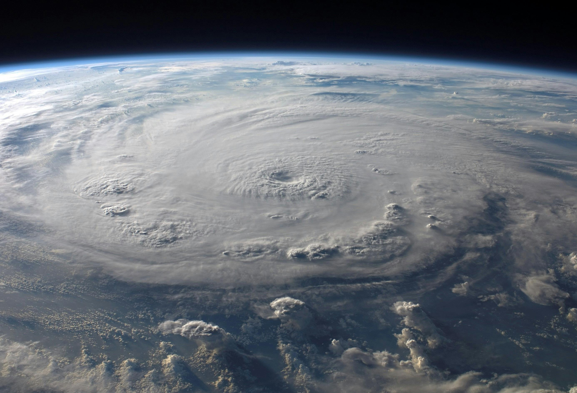
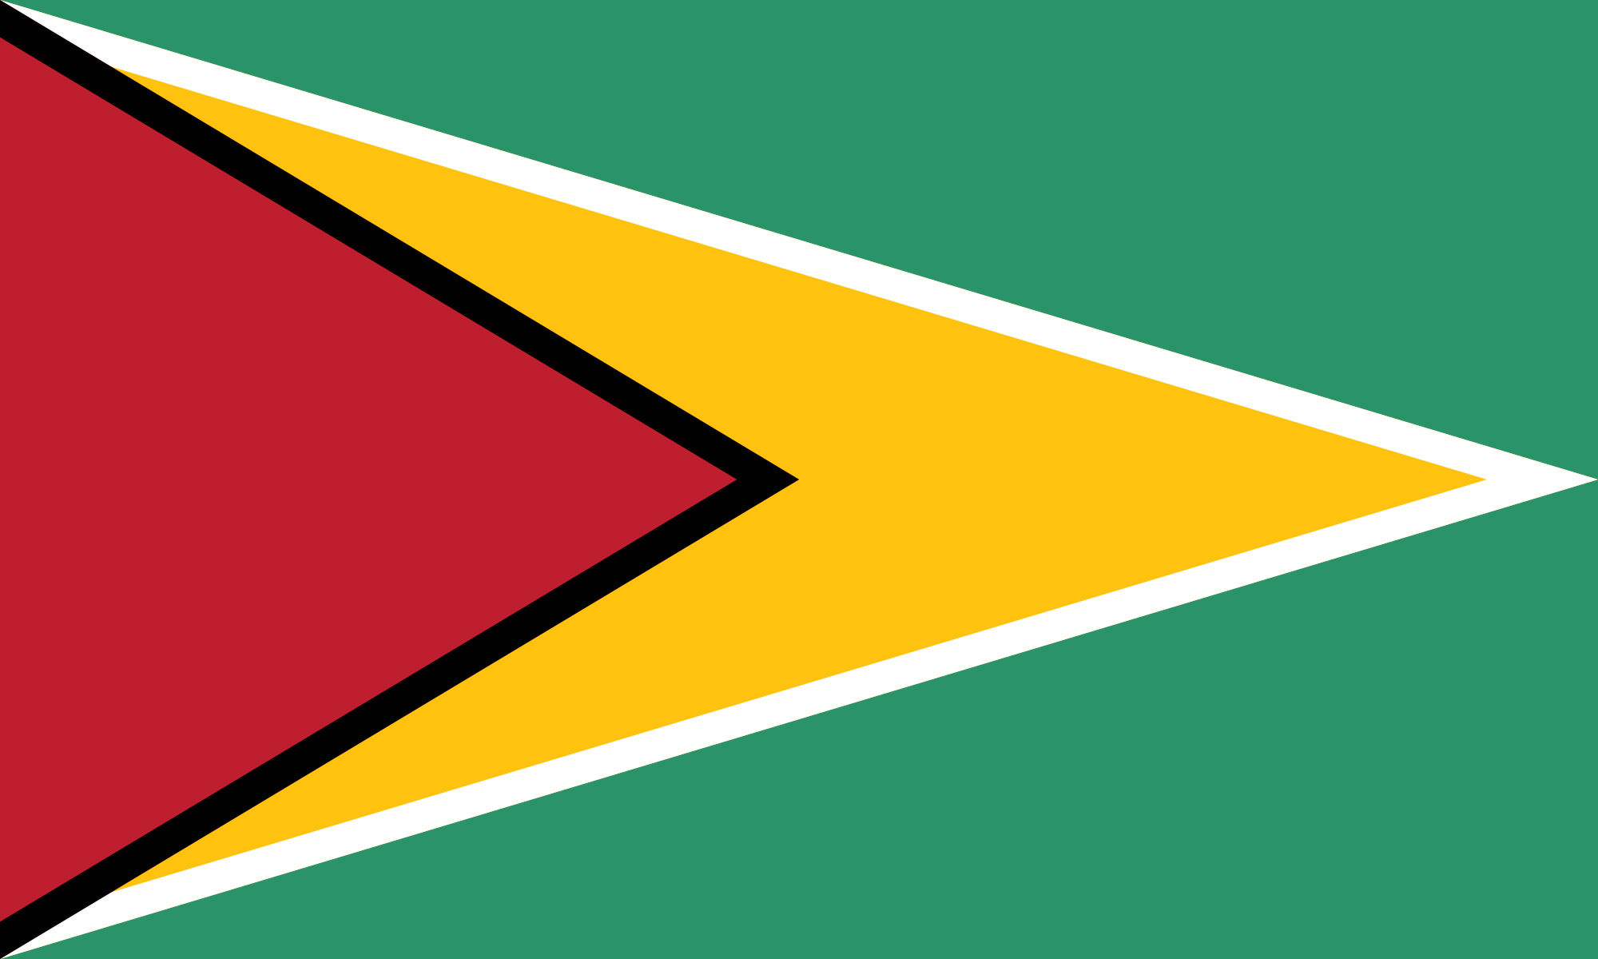
QUEEN’S COLLEGE GUYANA CODING TEAM LEVEL 1
CHALLENGE: GEOHAZARDS AND CLIMATE CHANGE
MEMBERS:
OMAR SHARIFF
MAHIR RAJKUMAR
NICHOLAS SAMDASS
SERAH RODRIGUES

Slide 2
This Scratch project was designed to raise awareness about geohazards and their various impacts, focused particularly on individuals residing in disaster-prone areas. It features three engaging point-and-click games, focusing on flash floods, hurricanes, and forest fires, where players must locate essential survival items. Each game includes a fun and interactive minigame to further educate you on steps useful for surviving disasters. With a clear and user-friendly main menu, the project provides an educational and entertaining way to help communities within the Caribbean better prepare for infamous natural disasters.

Slide 3
OUR APPROACH
For our geohazard awareness project, we assigned research to one member and divided the coding among three of us, with each member focusing on a specific game: flash floods, hurricanes, or forest fires. This allowed us to add unique elements to each game while staying true to the theme of helping people in disaster-prone areas prepare for emergencies. Each game challenges players to find survival items and includes a minigame that teaches important preparedness steps, creating an engaging and educational experience.
This Scratch project was designed to raise awareness about geohazards and their various impacts, focused particularly on individuals residing in disaster-prone areas. It features three engaging point-and-click games, focusing on flash floods, hurricanes, and forest fires, where players must locate essential survival items. Each game includes a fun and interactive minigame to further educate you on steps useful for surviving disasters. With a clear and user-friendly main menu, the project provides an educational and entertaining way to help communities within the Caribbean better prepare for infamous natural disasters.

Slide 4
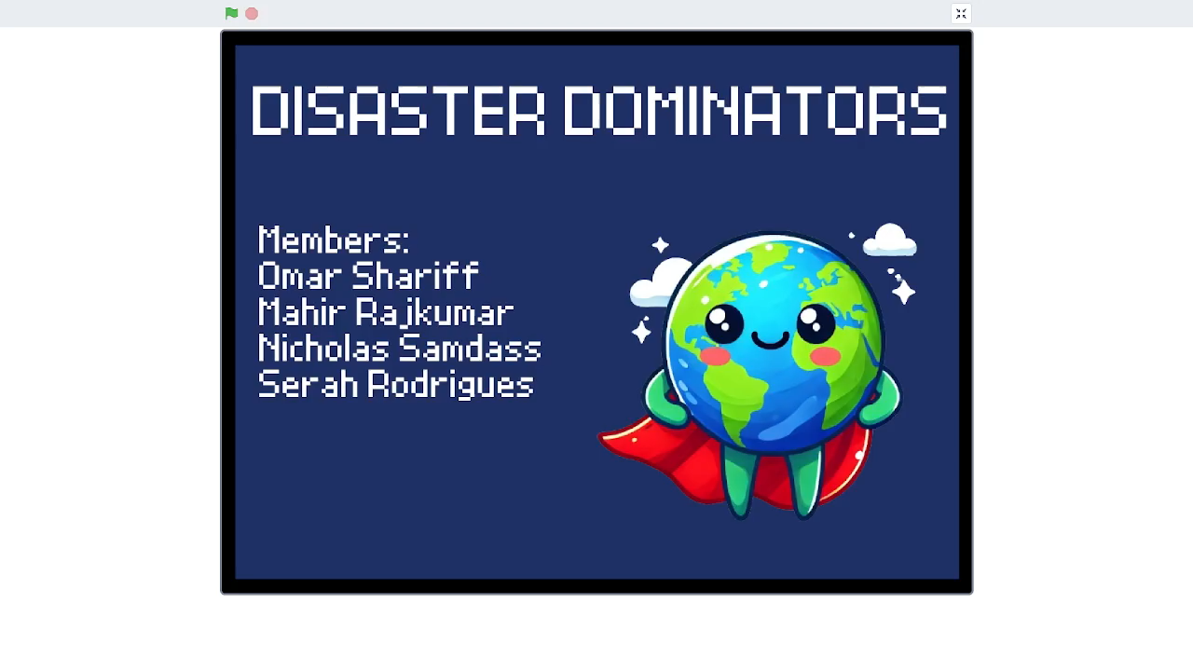



Slide 5
In wrapping up our project, we’re proud of what we’ve achieved. By focusing on flash floods, hurricanes, and forest fires, we created games that are both fun and educational, helping people understand how to prepare for these disasters. Each game teaches survival strategies in an interactive way, making the learning process engaging and memorable. This project has shown us how teamwork and creativity are essential in tackling real-world issues, and we hope it encourages others to stay informed and prepared for the unexpected.
THANK YOU FOR LISTENING!!

